Slide 1
机器人与人工智能实验室 Robotics and Artificial Intelligence Laboratory
WELCOME TO

Slide 2
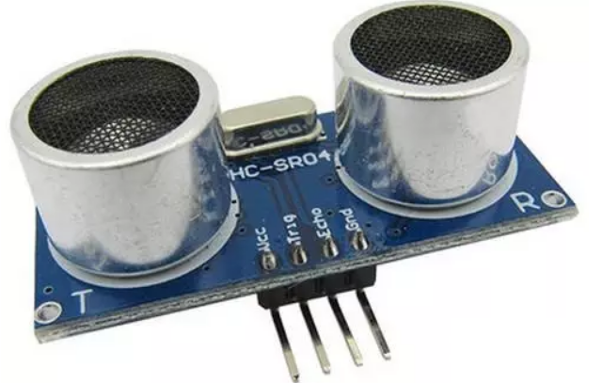
Ultrasonic Ranging
1. Introduction
Ultrasonic waves propagate in the air and are reflected back immediately when encountering obstacle. Based on the duration t, the distance of the obstacle can be calculated: s = 340× t / 2.

Slide 3
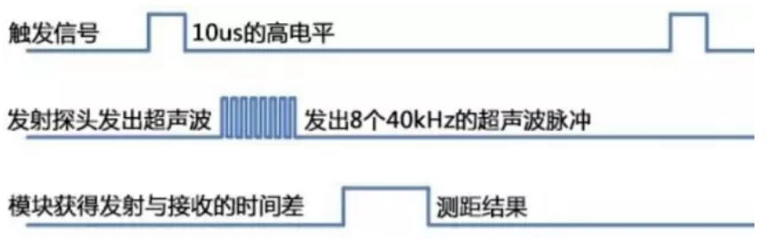
Ultrasonic Ranging
2. Principles of Module
(a) The TRIP pin is internally pulled up via a 10K resistor. During measurement, the TRIP pin is pulled low, and then a pulse signal of more than 10us is applied.

Slide 4
Ultrasonic Ranging
(b) The module automatically sends eight 40kHz square waves and detects whether a signal returns.
(c) When a signal returns, a high level is output through the Echo pin, and the duration of the high level is the time from the transmission of the ultrasonic wave to the return.

Slide 5
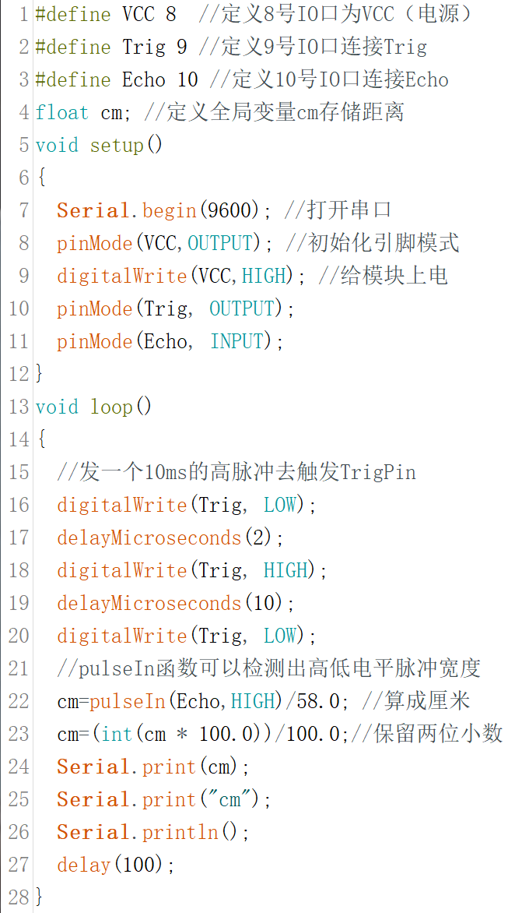
Ultrasonic Ranging
3. Coding
Give Trig a high level of 10us, and detect the high level duration of the echo pin. Obtain the obstacle distance by doing corresponding data processing on the duration.

Slide 6
Ultrasonic Ranging
4. Remarks
The data obtained by pulseIn is divided by 58. The duration for sound to travel 1 cm is 29.15 microseconds. The detected total time of sound propagation divided by 29.15 is used to figure out how many cm the sound has propagated.
Since this distance is actually twice the distance sought, it needs to be divided by 2 (i.e. pulseIn/ (29.15*2) = pulseIn/58.3).

Slide 7
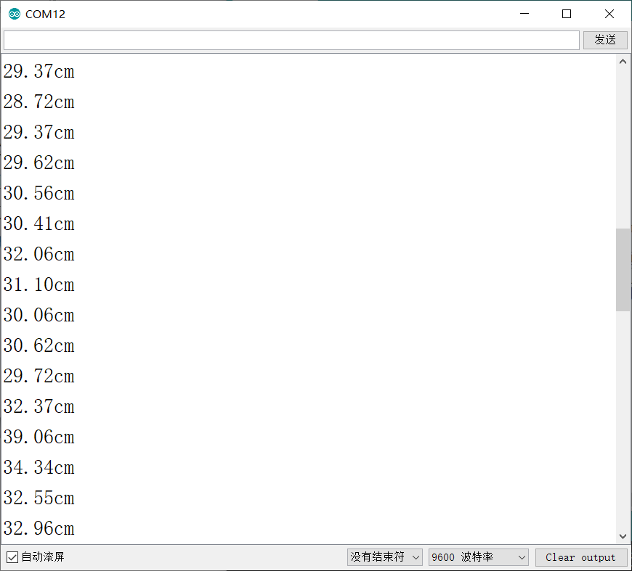
Ultrasonic Ranging
5. Monitoring
Upload the above program and see the data prompted on the serial monitor.
Theoretically, in order to prevent jitter, unreasonable data needs removal to ensure stability.

Slide 8

THANK YOU
林天麟 教授
香港中文大学（深圳）
机器人与人工智能实验室
WeChat: tinlunlam

